Slide 1
GESTURal musical interfaces
MASTERS PROJECT/ INDEPENDENT STUDY (ART 890)
Sandeep Dasari
Git: https://github.com/sandcobainer/gesturalmusicinterfaces

Slide 2
overview
Music Technology
Gesture Recognition
MIDI and Audio Synthesis
Max MSP
Machine Learning and Gesture Recognition in music
Real time application with Leap Motion
Future Work and Ideas

Slide 3
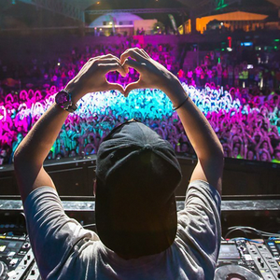
Music technology
Using technology to synthesize or shape sound
Djing, Electronic Dance Music (EDM)
Analog to Digital
New interfaces to control sound
Recording devices
Write new music
Tools to study sound and improve expression

Slide 4
MIDI
Musical Instrument Digital Interface is a protocol to connect electronic music instruments, computers and audio devices.
Just digital event messages specifying pitch (frequency), velocity (amplitude) machines, turn tables
Audio Science embraced by musicians
Detect hand distances to calculate
Pitch
Velocity
How can we improve on this?

Slide 5
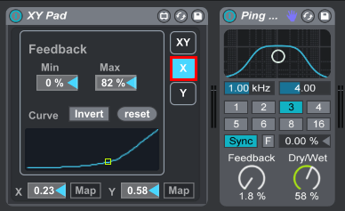
Audio synthesis
Power of MIDI and Digital Signal Processing
Faster computers -> MORE DSP
Softwares for audio synthesis and sound generation
Use gestures to control audio parameters in complex algorithms
Control multiple parameters on X, Y and Z axes
Spatial note arrangement around the artist

Slide 6
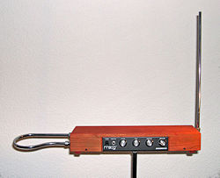
GESTURE RECOGNITION
Gestures are human movements that communicate a meaning.
Theremin is an electronic musical instrument controller without physical contact.
Add gesture recognition to an instrument or interface in real time
Classify hand gestures of the artist to perform changes in audio synthesis
Gestures fall into 2 kinds
1. static gestures
2. dynamic gestures

Slide 7
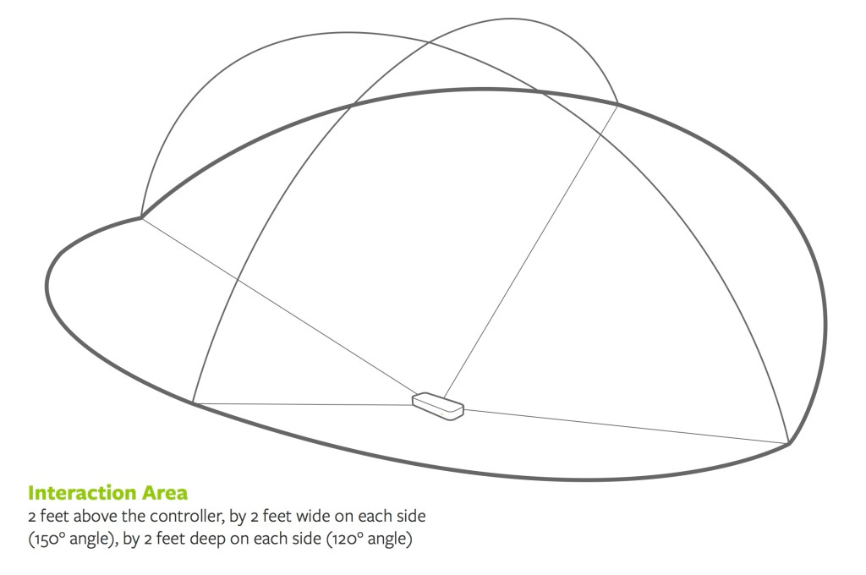
Machine learning for gesture recognition
Classifying static gestures is easier (use classification models)
Chose SVM (complex dataset with many gestures but less amount of data)
Classifying dynamic gestures is tricky (Hidden Markov Models?)
define start and end of a gesture
speed of the gesture
Occlusion (overlapping hands)
noise (partial misclassification)

Slide 8
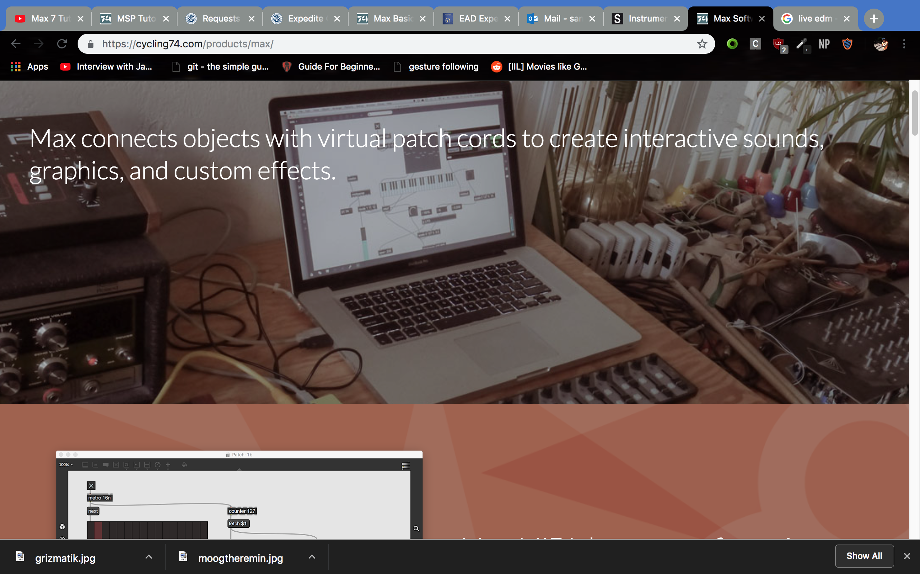
Max / MSp for real time MACHINE LEARNING
Flexible (own patches)
Modular
Easy data handling
Documentation / community
Fast and real time
Easy to prototype models
Built for Audio Synthesis
Simple predefined models

Slide 9
Data acquisition and features
Leap Motion is a computer hardware sensor that supports hand and finger motions as input without touching.
Detailed 3-D coordinates of fingers, bones, palm and elbow positions
Building features
distance between fingers to palm
distance between fingers
distance between pointing fingers and thumb
Feature set is a list of 12 euclidean distances

Slide 10
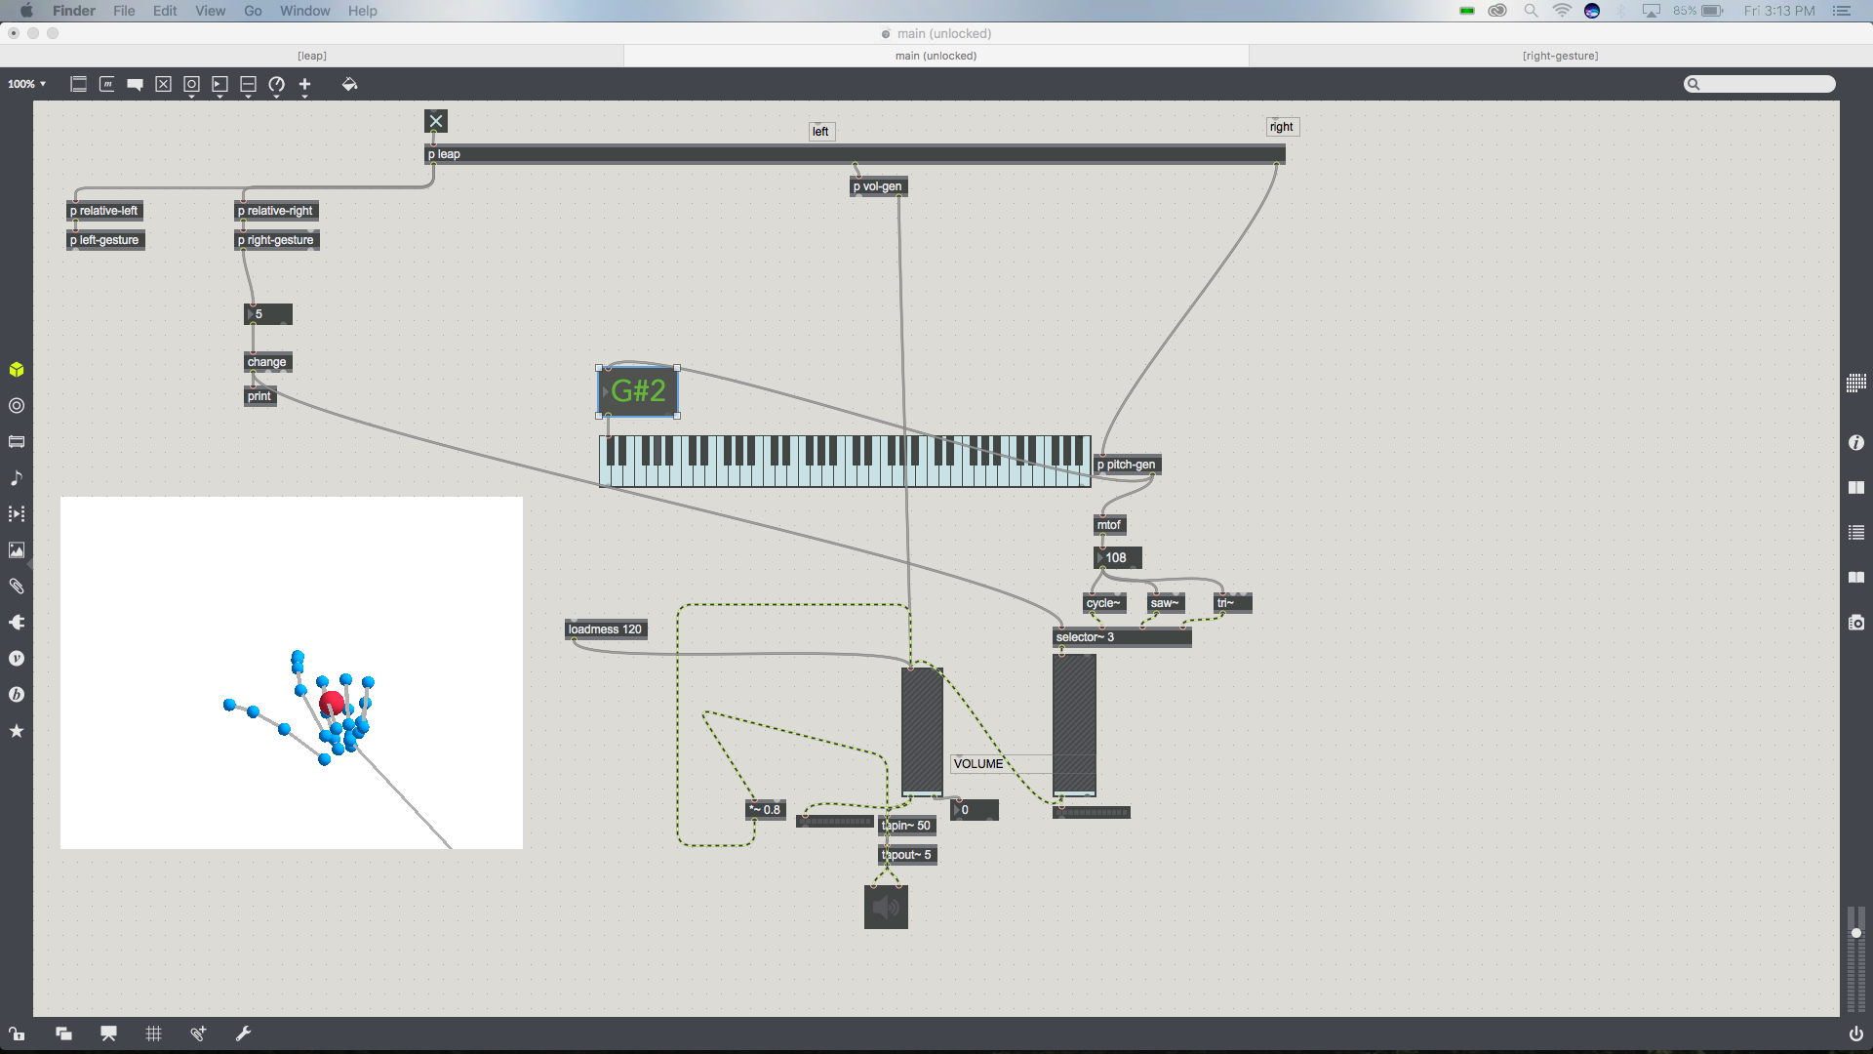
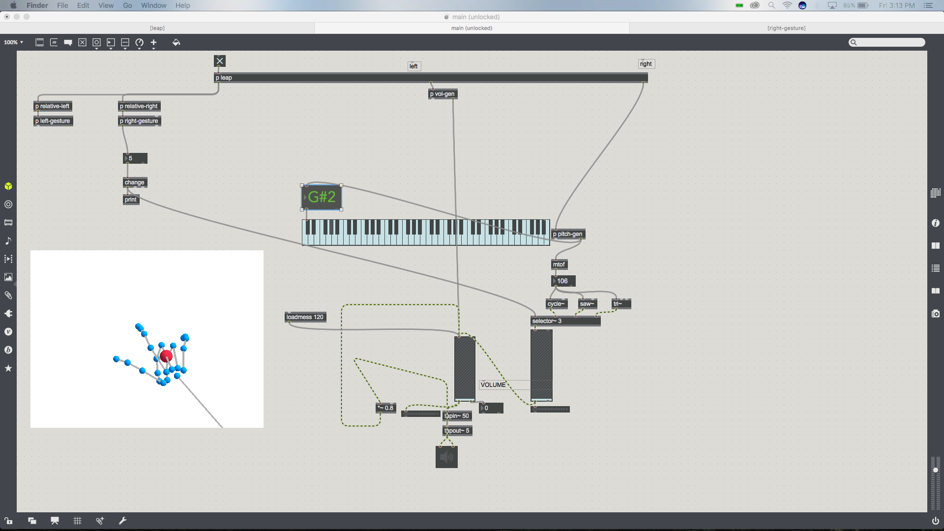
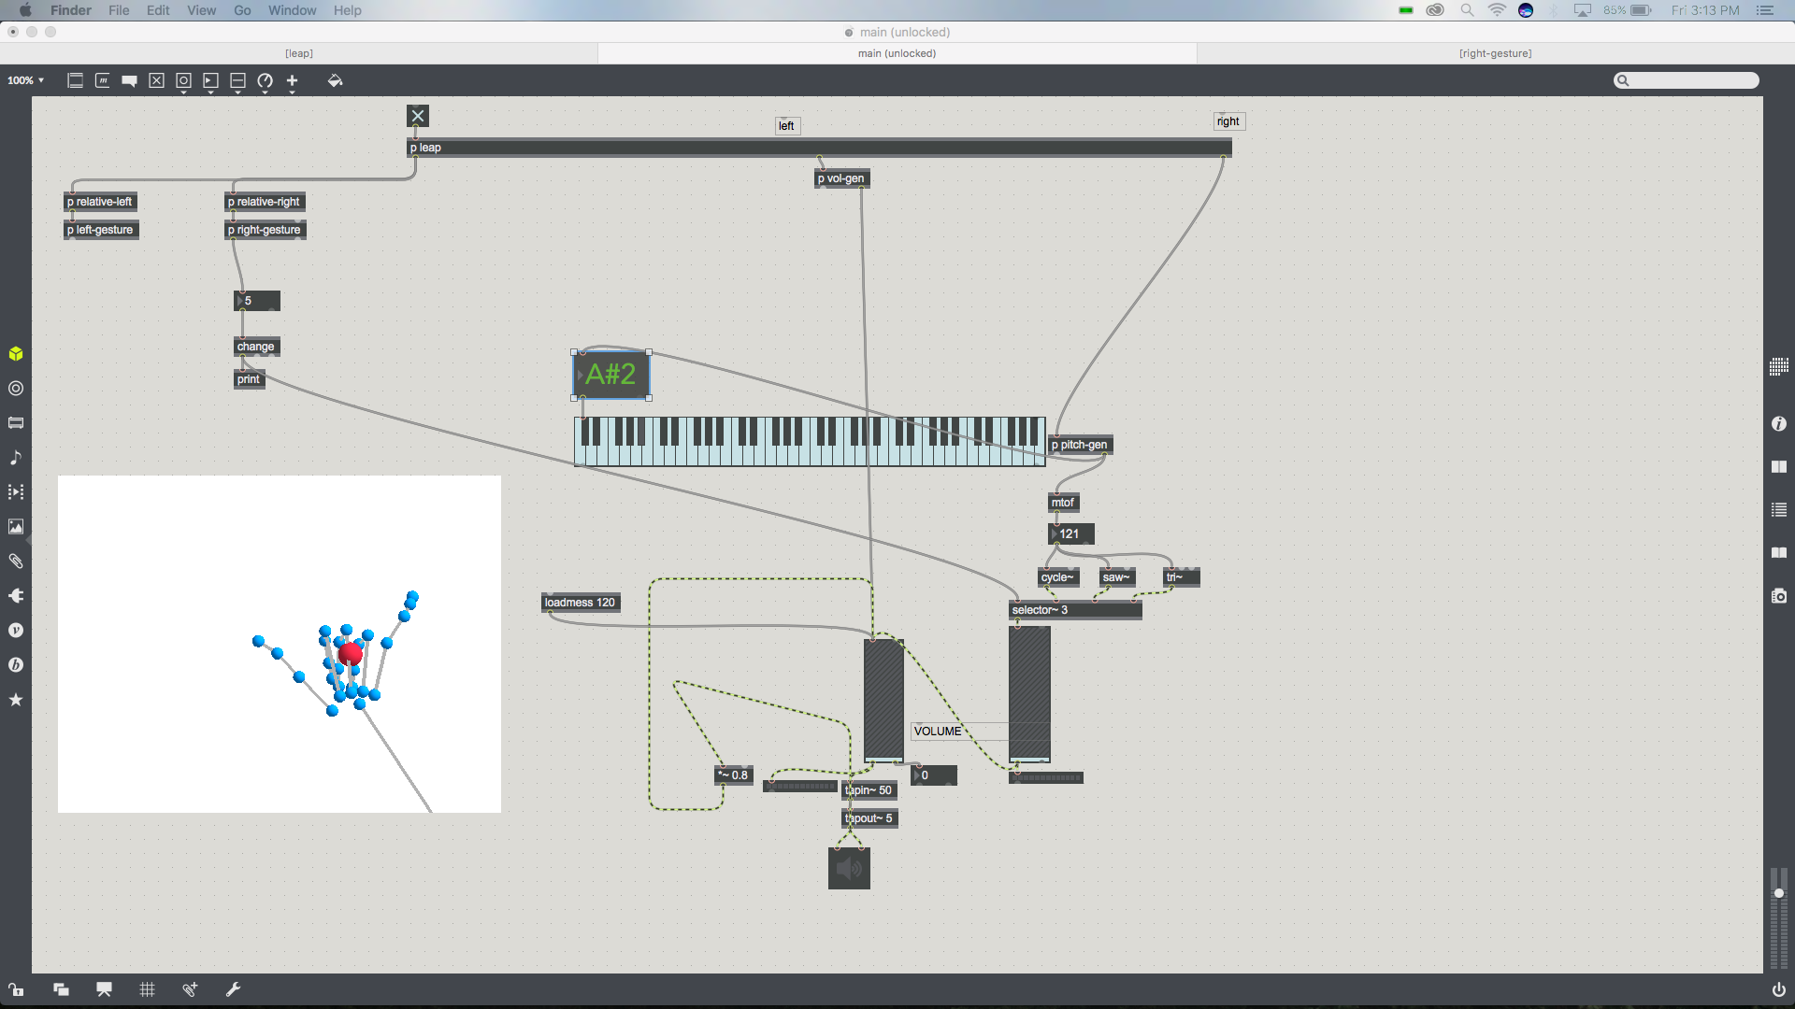
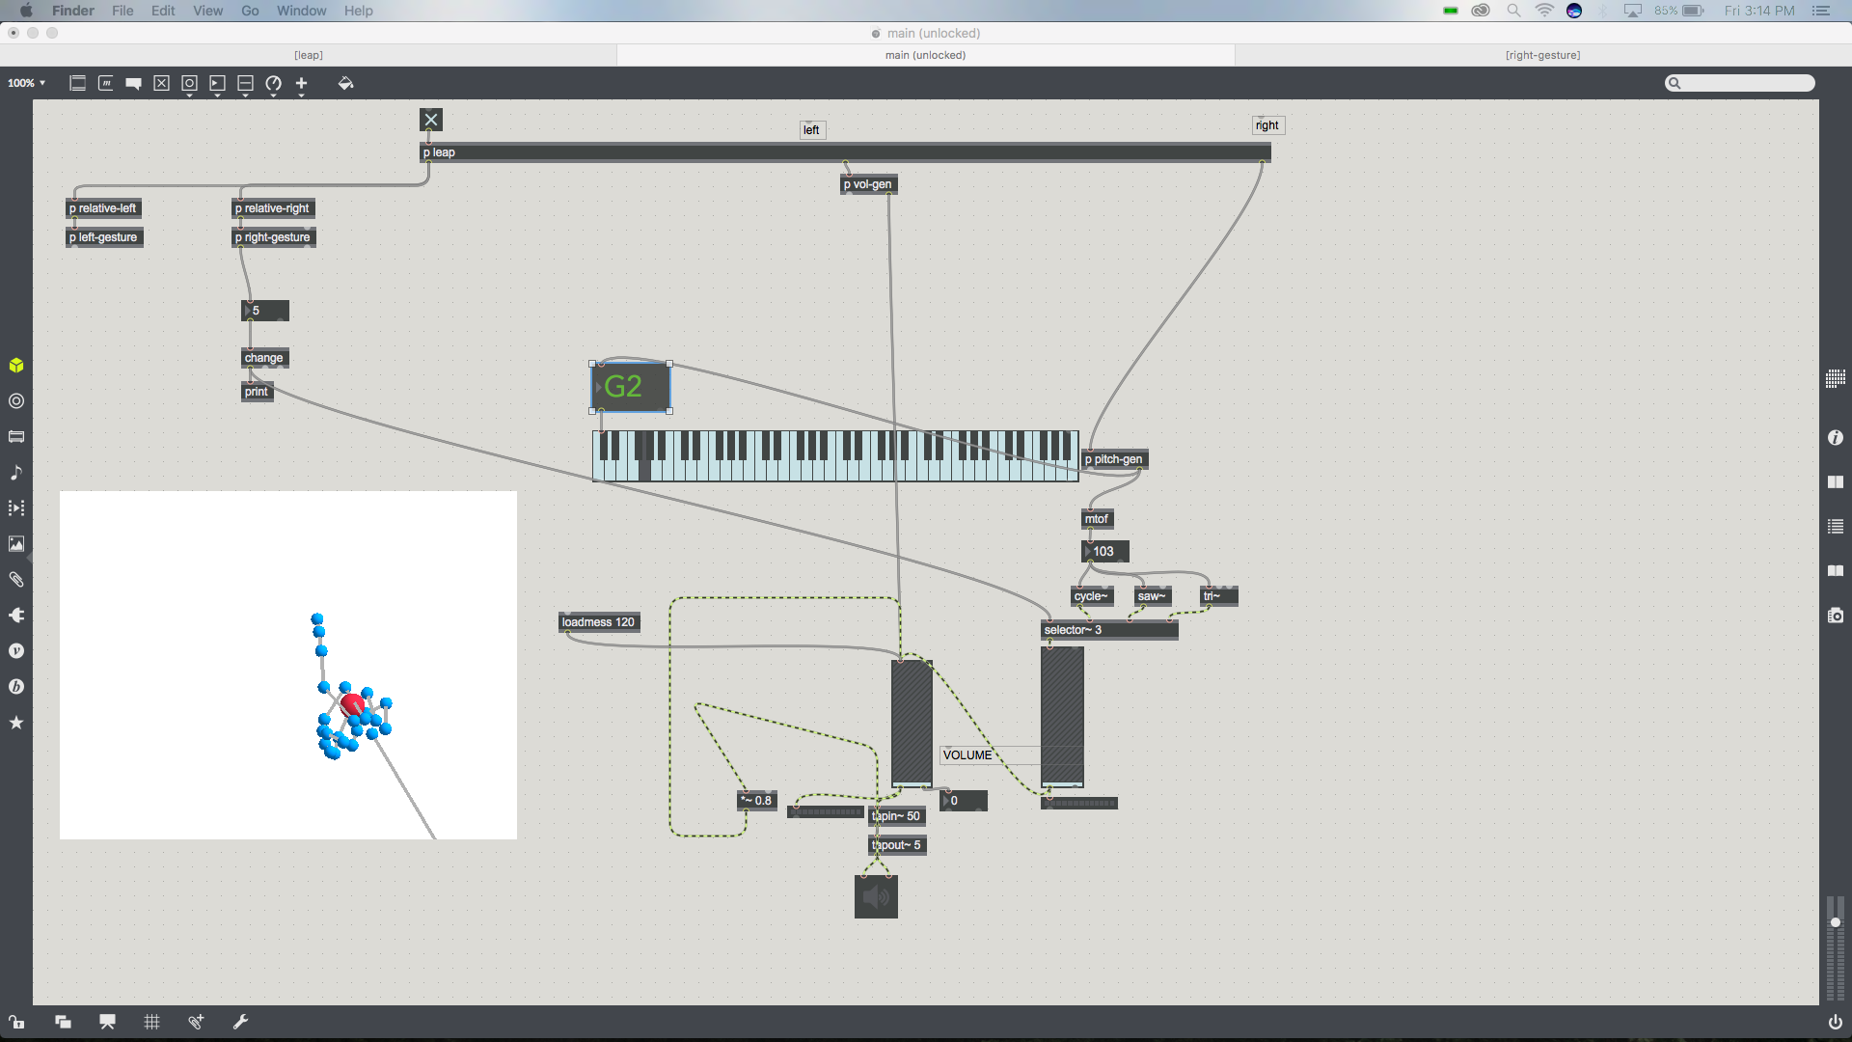
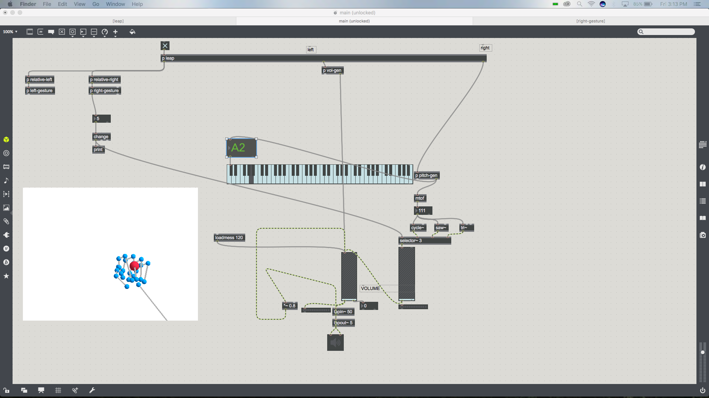

Classified gestures
Gesture 1
Gesture 2
Gesture 3
Gesture 4
Gesture 5
Gesture 6

Slide 11
Framework mapping ideas
Keeping everything inside MAX/MSP
Easy to build and release Max for Live plugins for Ableton Live
MIDI keyboard for scoring movies
Interface to control knobs, pedals and switches in a DAW
Granular synth to control voices
DJ turntable for scratching?

Slide 12
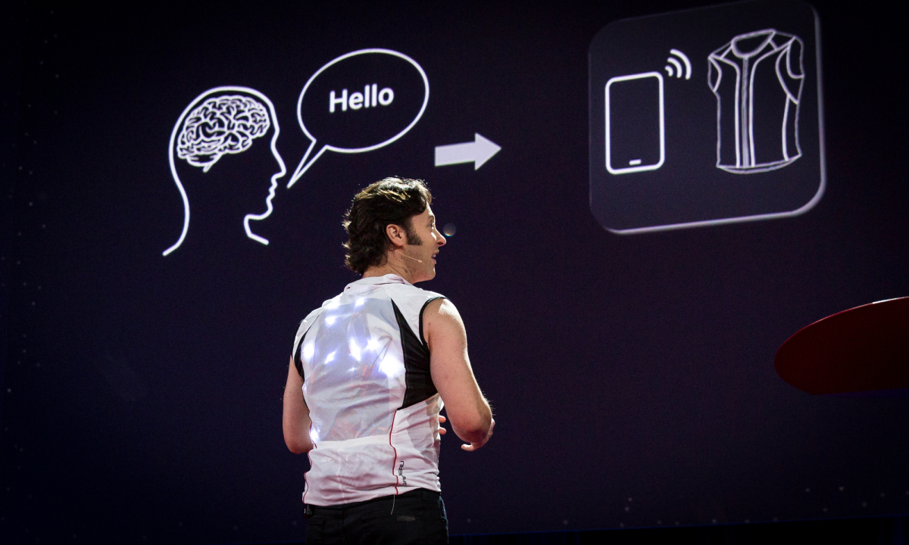
FUTURE WORK
Improve kinds of sounds generated on the sampling or synthesis end
Dynamic gestures
Use gesture following for detecting partial gestures – ACTIVE AREA OF RESEARCH
Use this to study neuroscience problems
Embodied music cognition
Proprioception
Haptic Feedback

Slide 13
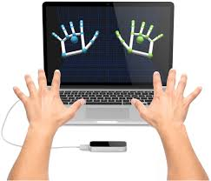
Questions/Feedback?

